Slide 1
DigiSchools
FYP Project

Slide 2

Introduction
Software systems for school management
Learning Management Systems (LMS)
Schools learning environment and processes

Slide 3


Problem Identification
Pandemic Situations
Before and After Pandemic Situations

Slide 4

Problem Identification
Digitalized learning management is need

Slide 5

Project Objectives
Manual to digitalization
Reduce physical interaction and provide formal communication platform.
Reduce workload for staff and students.
Easy access to content.
Enhance efficiency.
Preservation of records.

Slide 6
Literature Review
Modules and Features | Google Classroom | Moodle | eSchool | Fekara | QuickSchools | schoolpk | Proposed System
Attendance Feature | × | ✓ | ✓ | ✓ | ✓ | ✓ | ✓
Admission Feature | ✓ | ✓ | ✓ | ✓ | ✓ | ✓ | ✓
Grading Portal | ✓ | ✓ | ✓ | × | ✓ | ✓ | ✓
LMS | ✓ | ✓ | × | ✓ | × | × | ✓
User -Friendly Interface | ✓ | ✓ | ✓ | × | ✓ | × | ✓
Localized Storage | × | × | × | × | × | × | ✓

Slide 7

Project Goals
To investigate the existing schools CMS and LMS systems.
To develop a web-based application with LMS and CMS features for schools.
To test the functionalities of the system
To deploy our system.

Slide 8
Methodology
Requirements Phase
User
Functional
Non-Functional
Design Phase
Entity Relationship
System Modeling
Architectural Design
Test Cases
Implementation Phase
Database
System Development
Deployment Phase
Installation
Testing
Testing Phase
Unit Testing
Integration Testing
System Testing
Acceptance Testing

Slide 9
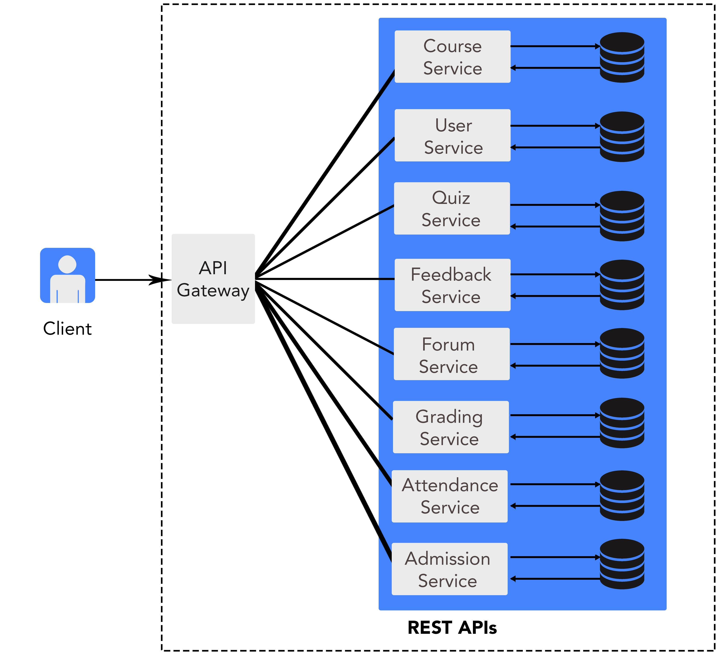
Architecture

Slide 10


Technology
React JS
JS Library to create UI components
Virtual DOM
Node JS
Non-Blocking Mechanism
Super-Fast
Asynchronous
Easy to learn
Less Development Time

Slide 11
Milestones and Deliverables
Abstract Defense
Project Abstract
Document
Proposal Defense
Project Proposal
Document
FYP-I (Mid Defense)
SRS
SDS
FYP-II (Final Defense)
Complete Software
System
Final Report

Slide 12
Work Division
Hafiz Abdulrehman – Muhammad Daniyal
Muhammad Saif Ibrahim –
Sumra Bibi
Work Package/Activity Name | Group Member Name
Project Proposal Document | All Members
Software Requirement Document | All Members
Software design Document | All Members
Implementation (Front End Design, Back-end development, Database Design)
Examination Module: | Front End: Muhammad Saif Ibrahim, Sumra Bibi Back End: Hafiz Abdul Rehman, Muhammad Daniyal Database Design: Hafiz Abdul Rehman, Muhammad Daniyal Unit Testing: Muhammad Saif Ibrahim, Sumra Bibi
Attendance Module: | Front End: Muhammad Saif Ibrahim, Sumra Bibi Back End: Hafiz Abdul Rehman, Muhammad Daniyal Database Design: Hafiz Abdul Rehman, Muhammad Daniyal Unit Testing: Muhammad Saif Ibrahim, Sumra Bibi
LMS Module: | Front End: Hafiz Abdul Rehman, Muhammad Daniyal Back End: Muhammad Saif Ibrahim, Sumra Bibi Database Design: Muhammad Saif Ibrahim, Sumra Bibi Unit Testing: Muhammad Saif Ibrahim, Sumra Bibi
Admission Module: | Front End: Hafiz Abdul Rehman, Muhammad Daniyal Back End: Muhammad Saif Ibrahim, Sumra Bibi Database Design: Muhammad Saif Ibrahim, Sumra Bibi Unit Testing: Muhammad Saif Ibrahim, Sumra Bibi
Front End
Back End
Database
Unit Testing
Front End
Back End
Database
Unit Testing
Front End
Back End
Database
Unit Testing
Front End
Back End
Database
Unit Testing

Slide 13
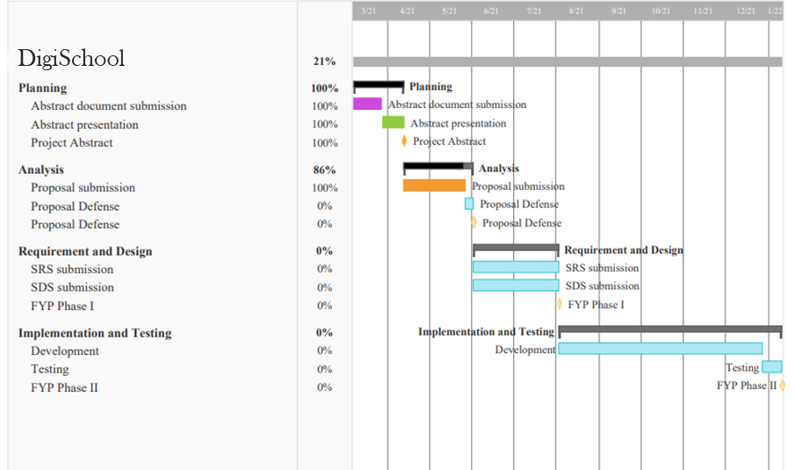
Timeline

Slide 14
Cost
Resource or Activity | Approximate Cost
Storage | Free (During Development)
Implementation | None
Database server | Free (Free Development)
Software (premium) and Hardware cost | None
* Only hosting charges will be applied

Slide 15
Questions?

